Slide 1
Introduction to ARIMA
Lecture 3

Slide 2
Recap
How to make data stationary?
Transformations (log, other)
Detrending
Linear regression
Moving average smoother
Kernel smoother
Other
How shall we model the data after detrending and transformations (residuals)?→ARIMA models!

Slide 3
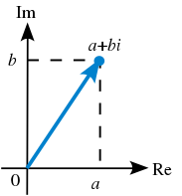
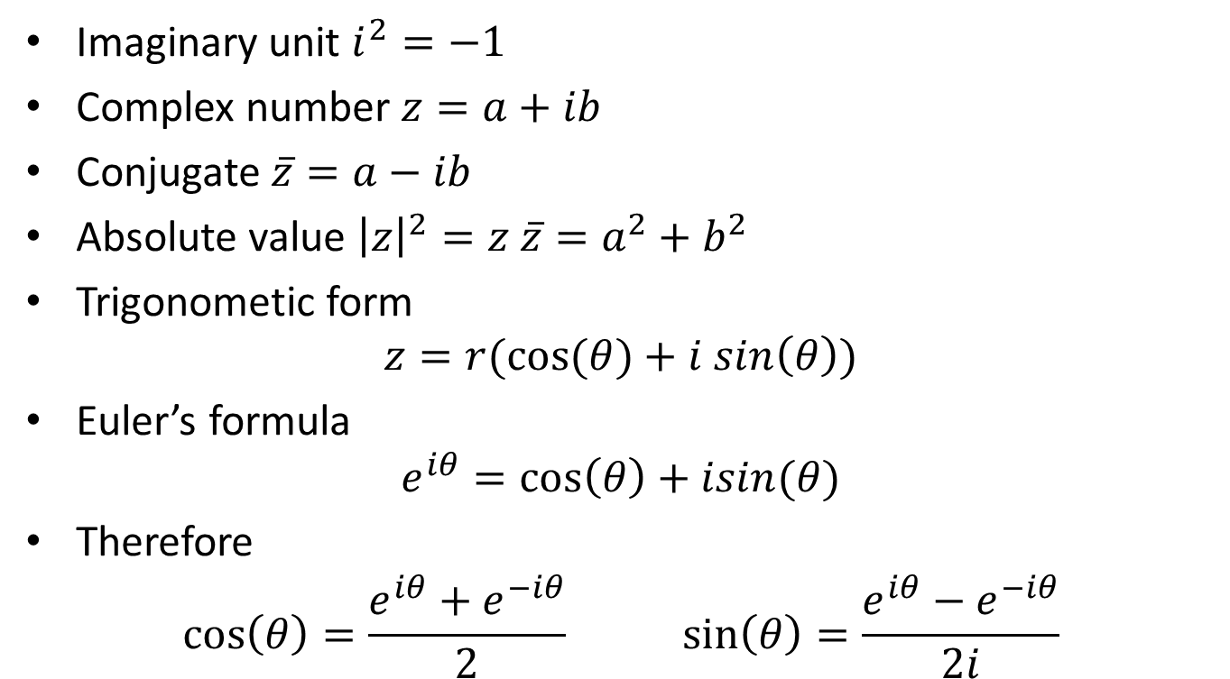
Reminder: complex numbers
Imaginary unit $i^{2}=−1$
Complex number $z=a+ib$
Conjugate $\overline{z}=a−ib$
Absolute value ${\left|z\right|}^{2}=z \overline{z}=a^{2}+b^{2}$
Trigonometic form
$$z=r(cos⁡(θ)+i sin\left(θ\right))$$
Euler’s formula
$$e^{iθ}=\cos\left(θ\right)+isin(θ)$$
Therefore
$$\cos\left(θ\right)=\frac{e^{iθ}+e^{−iθ}}{2} \sin\left(θ\right)=\frac{e^{iθ}−e^{−iθ}}{2i}$$
Wikipedia

Slide 4

Reminder: polynomials
Any polynomial $P_{r}\left(x\right)$of degree $r$ can be written as
$P_{r}\left(x\right)=a\left(x−z_{1}\right)…(x−z_{r})$
where $z_{i}$ are roots (real or complex)
If $z_{i}$ is a root, ${\overline{z}}_{i}$ is also a root

Slide 5
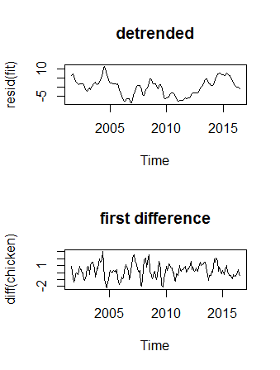
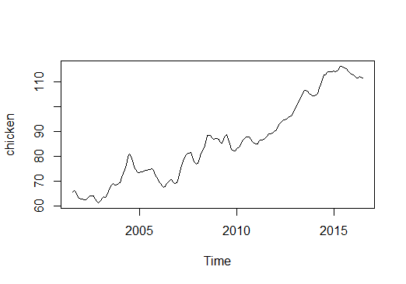
ARIMA models
Why ARIMA models?
Removing trend is not sufficient

Slide 6
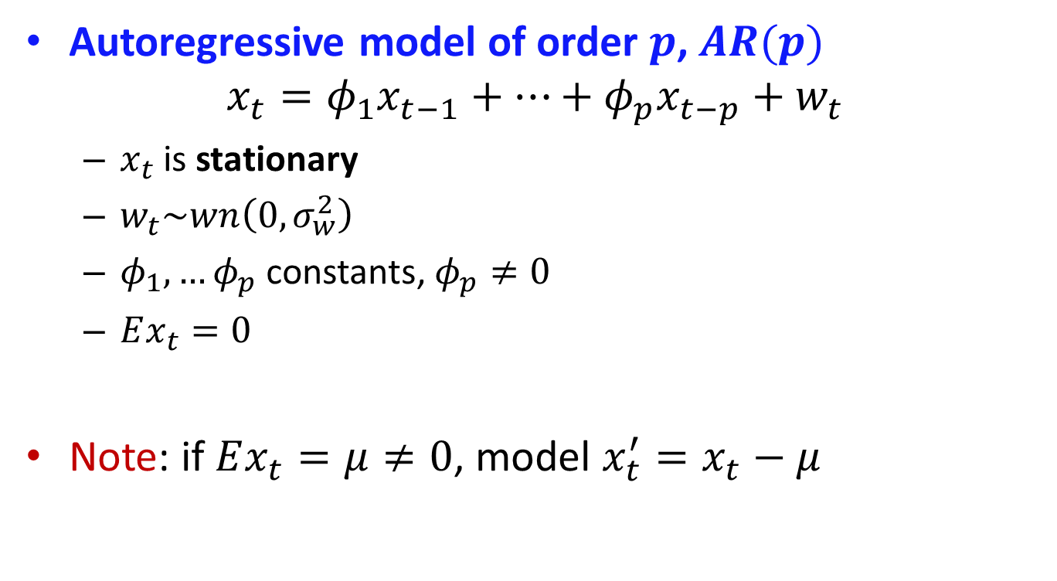
AR models
Autoregressive model of order $p$, $AR(p)$
$$x_{t}=φ_{1}x_{t−1}+…+φ_{p}x_{t−p}+w_{t}$$
$x_{t}$ is stationary
$w_{t}\sim wn\left(0,σ_{w}^{2}\right)$
$φ_{1},…φ_{p}$ constants, $φ_{p}≠0$
$Ex_{t}=0$
Note: if $Ex_{t}=μ≠0$, model $x_{t}^{′}=x_{t}−μ$

Slide 7

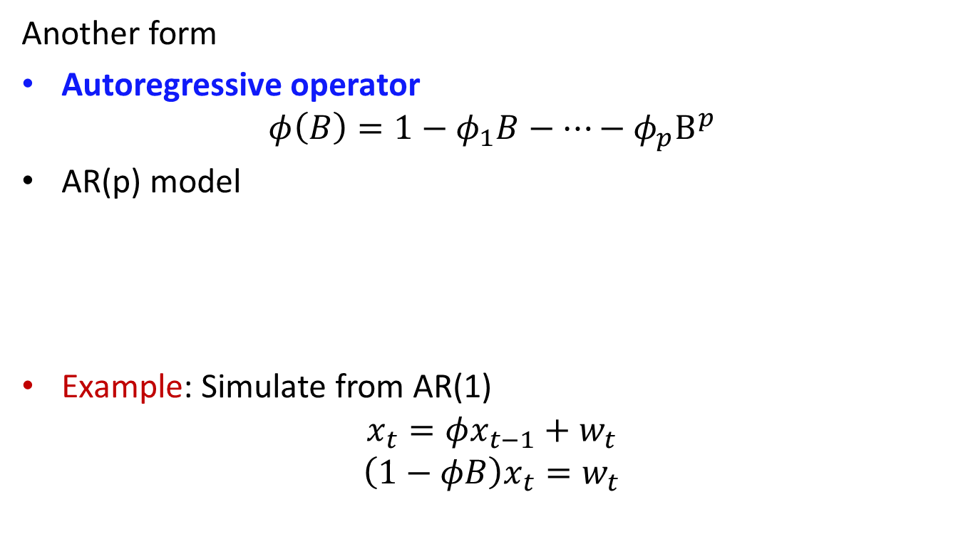
AR models
Another form
Autoregressive operator
$$φ\left(B\right)=1−φ_{1}B−…−φ_{p}B^{p}$$
AR(p) model
Example: Simulate from AR(1)
$$x_{t}=φx_{t−1}+w_{t}$$
$$\left(1−φB\right)x_{t}=w_{t}$$
$$φ\left(B\right)x_{t}=w_{t}$$

Slide 8
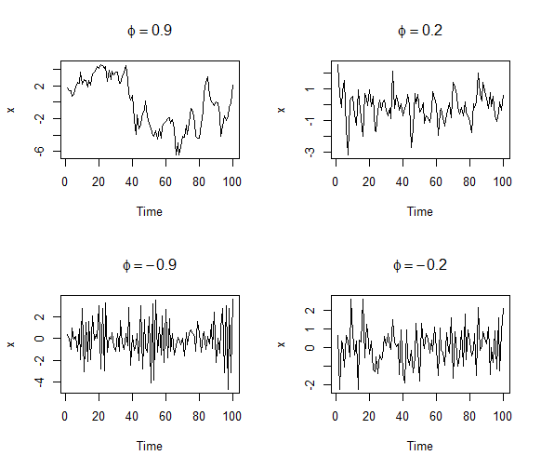
AR(1)
How do these plots differ?

Slide 9
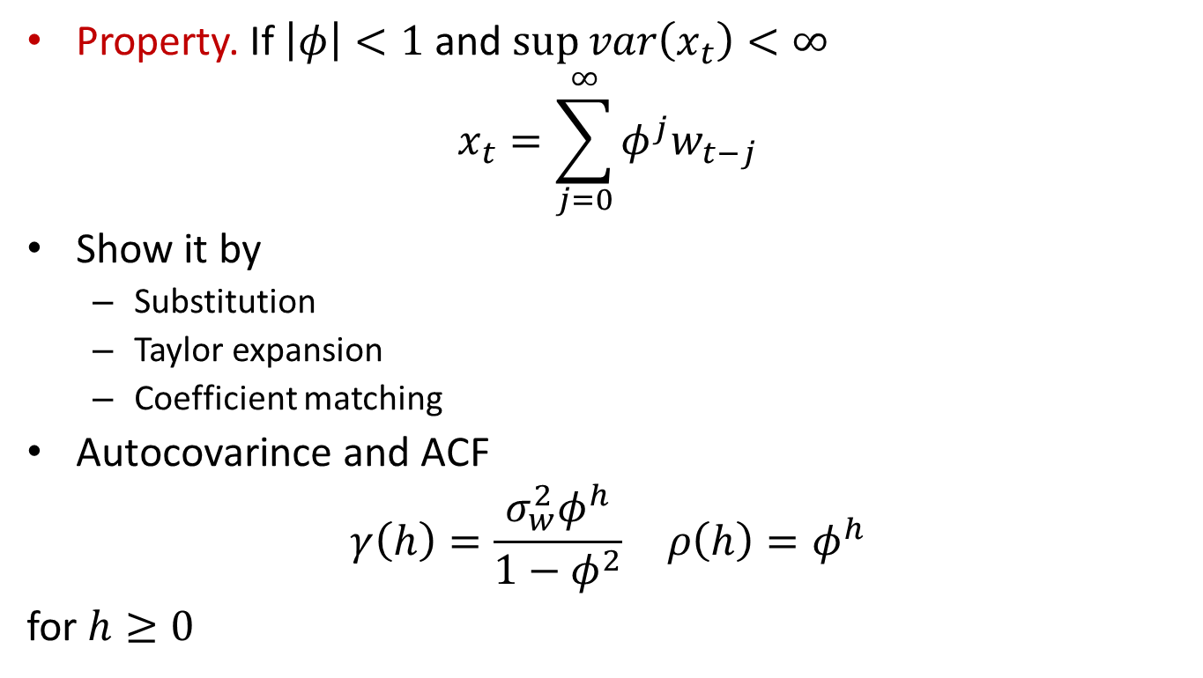
AR(1)
Property. If $\left|φ\right|<1$ and $\sup{var\left(x_{t}\right)<∞}$
$$x_{t}=\sum_{j=0}^{∞}{φ^{j}w_{t−j}}$$
Show it by
Substitution
Taylor expansion
Coefficient matching
Autocovarince and ACF
$$\begin{matrix}γ\left(h\right)=\frac{σ_{w}^{2}φ^{h}}{1−φ^{2}} & ρ\left(h\right)=φ^{h}\end{matrix}$$
for $h≥0$

Slide 10
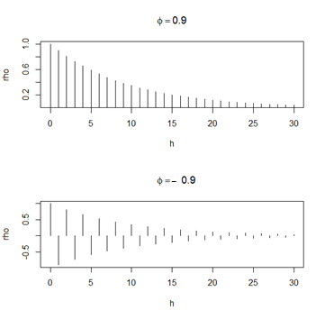

AR(1)
ACF for different $φ$
Check how ACF related to sample path

Slide 11
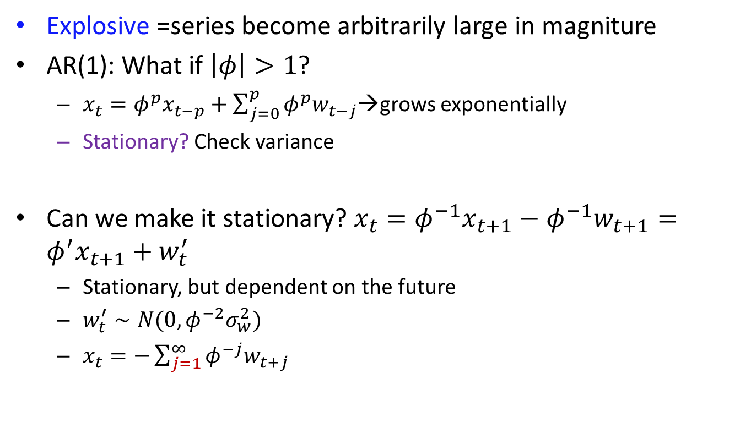
Explosive AR models
Explosive =series become arbitrarily large in magniture
AR(1): What if $\left|φ\right|>1$?
$x_{t}=φ^{p}x_{t−p}+\sum_{j=0}^{p}{φ^{p}w_{t−j}}$→grows exponentially
Stationary? Check variance
Can we make it stationary? $x_{t}=φ^{−1}x_{t+1}−{φ^{−1}w}_{t+1}=φ^{′}x_{t+1}+w_{t}^{′}$
Stationary, but dependent on the future
$w_{t}^{′}∼N(0,φ^{−2}σ_{w}^{2})$
$x_{t}=−\sum_{j=1}^{∞}{φ^{−j}w_{t+j}}$

Slide 12
Causial process
Def. The stationary process is causial if it is only dependent on the past values of the process
AR(1) causial
Explosive AR is not

Slide 13
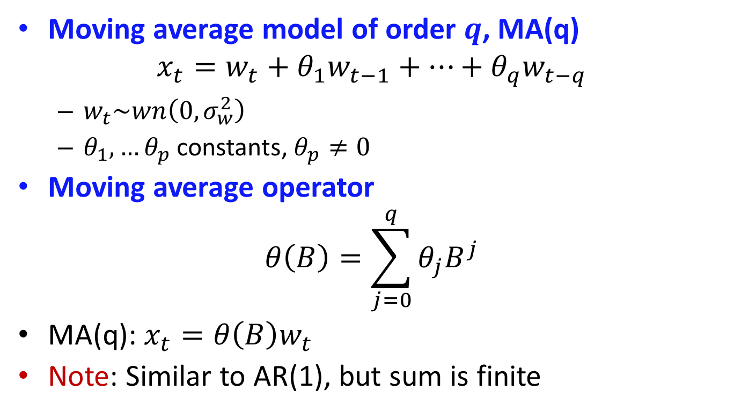
Moving average models
Moving average model of order $q$, MA(q)
$$x_{t}=w_{t}+θ_{1}w_{t−1}+…+θ_{q}w_{t−q}$$
$w_{t}\sim wn\left(0,σ_{w}^{2}\right)$
$θ_{1},…θ_{p}$ constants, $θ_{p}≠0$
Moving average operator
$$θ\left(B\right)=\sum_{j=0}^{q}{θ_{j}B^{j}}$$
MA(q): $x_{t}=θ\left(B\right)w_{t}$
Note: Similar to AR(1), but sum is finite

Slide 14
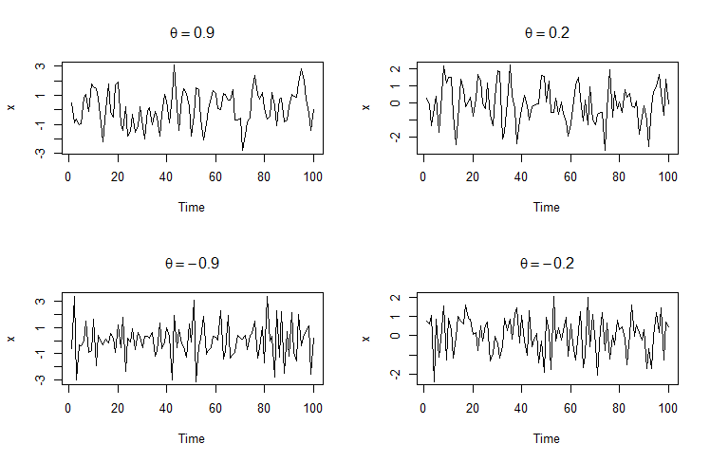

MA(1)
$$x_{t}=w_{t}+θw_{t−1}$$
Differences?

Slide 15

MA(1)
Autocovariance and ACF
$$γ\left(h\right)=\left\{\begin{aligned}\left(1+θ^{2}\right)σ_{w}^{2}, h=0 \\ θσ_{w}^{2}, h=1 \\ 0, h>1\end{aligned}\right.$$
$$ρ\left(h\right)=\left\{\begin{aligned}\frac{θ}{1+θ^{2}}, h=1 \\ 0, h>1\end{aligned}\right.$$
Process is stationary

Slide 16
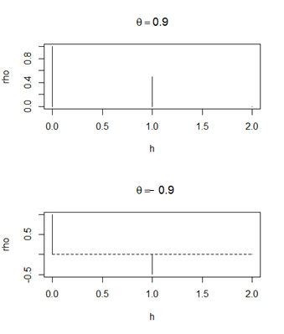

MA(1)
Note: $ρ\left(0\right)=1$ is often not shown→ only 1 bar

Slide 17
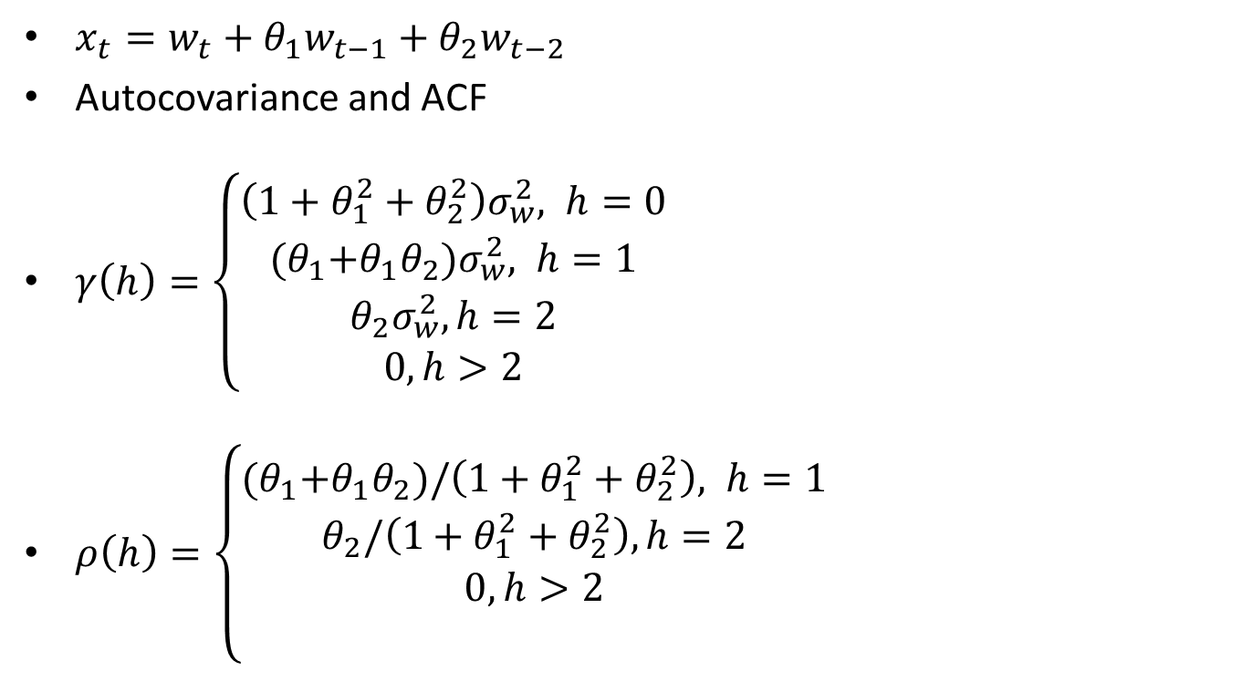
MA(2)
$x_{t}=w_{t}+θ_{1}w_{t−1}+θ_{2}w_{t−2}$
Autocovariance and ACF
$γ\left(h\right)=\left\{\begin{aligned}\left(1+θ_{1}^{2}+θ_{2}^{2}\right)σ_{w}^{2}, h=0 \\ {(θ}_{1}+θ_{1}θ_{2})σ_{w}^{2}, h=1 \\ θ_{2}σ_{w}^{2}, h=2 \\ 0, h>2\end{aligned}\right.$
$ρ\left(h\right)=\left\{\begin{aligned}{(θ}_{1}+θ_{1}θ_{2})/\left(1+θ_{1}^{2}+θ_{2}^{2}\right), h=1 \\ θ_{2}/\left(1+θ_{1}^{2}+θ_{2}^{2}\right), h=2 \\ 0, h>2 \\ \end{aligned}\right.$

Slide 18
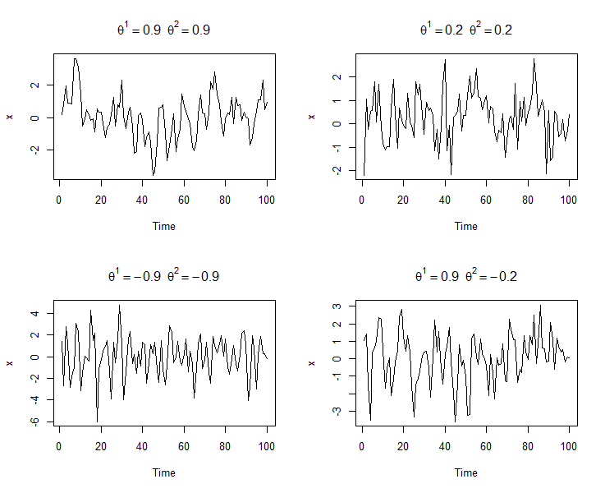
MA(2)
Differences?

Slide 19
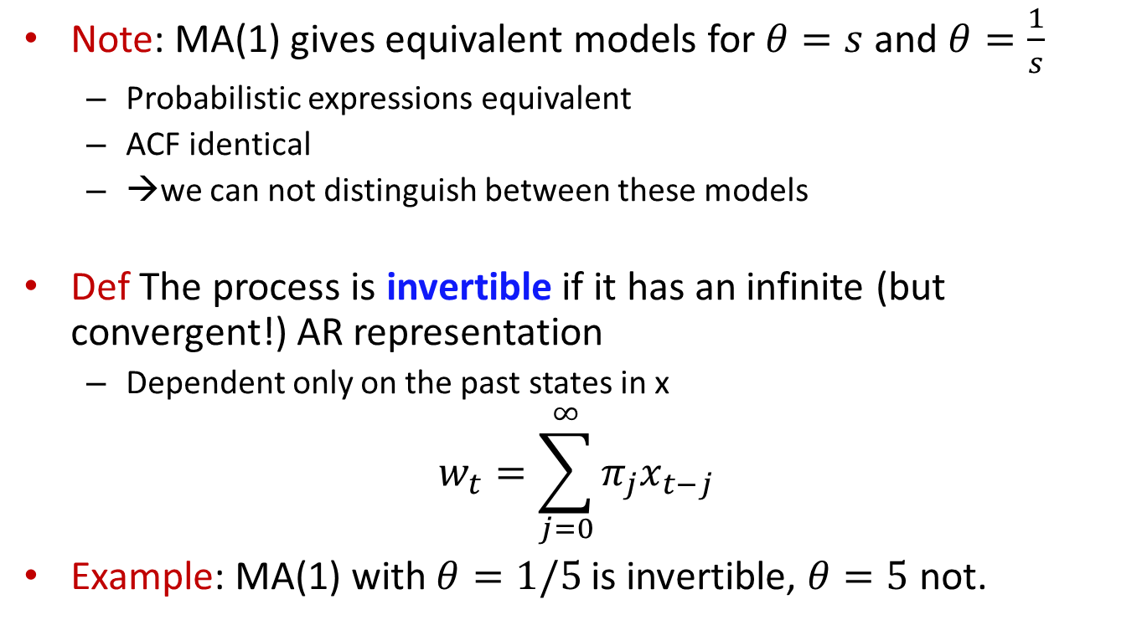
Invertibility
Note: MA(1) gives equivalent models for $θ=s$ and $θ=\frac{1}{s}$
Probabilistic expressions equivalent
ACF identical
→we can not distinguish between these models
Def The process is invertible if it has an infinite (but convergent!) AR representation
Dependent only on the past states in x
$$w_{t}=\sum_{j=0}^{∞}{π_{j}x_{t−j}}$$
Example: MA(1) with $θ=1/5$ is invertible, $θ=5$ not.

Slide 20

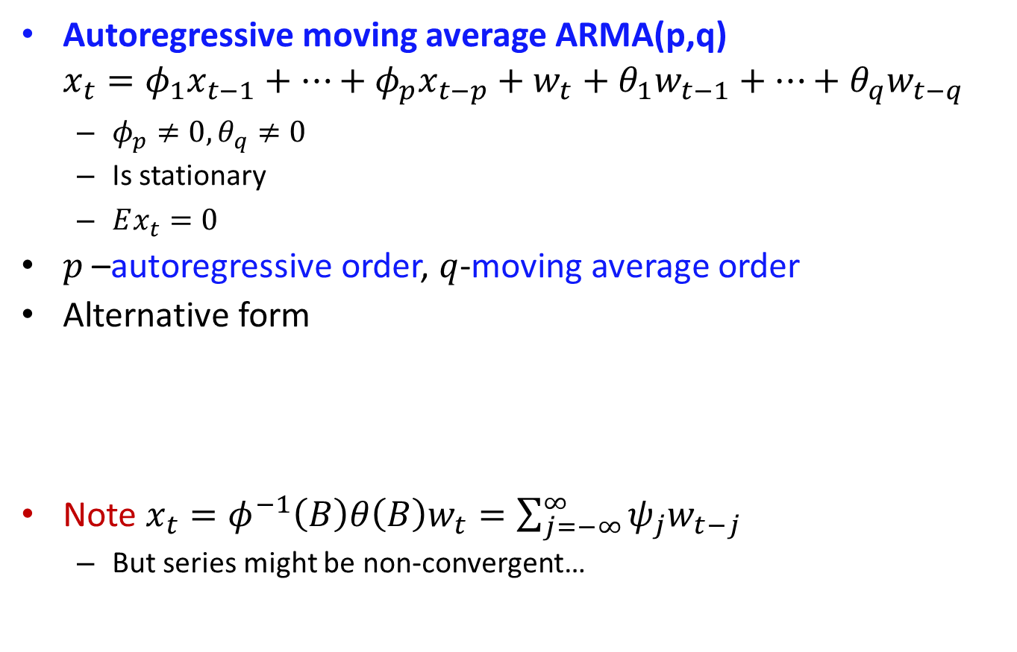
ARMA models
Autoregressive moving average ARMA(p,q)
$$x_{t}=φ_{1}x_{t−1}+…+φ_{p}x_{t−p}+w_{t}+θ_{1}w_{t−1}+…+θ_{q}w_{t−q}$$
$φ_{p}≠0, θ_{q}≠0$
Is stationary
$Ex_{t}=0$
$p$ –autoregressive order, $q$-moving average order
Alternative form
Note $x_{t}=φ^{−1}\left(B\right)θ\left(B\right)w_{t}=\sum_{j=−∞}^{∞}{ψ_{j}w_{t−j}}$
But series might be non-convergent…
$$φ\left(B\right)x_{t}=θ\left(B\right)w_{t}$$

Slide 21
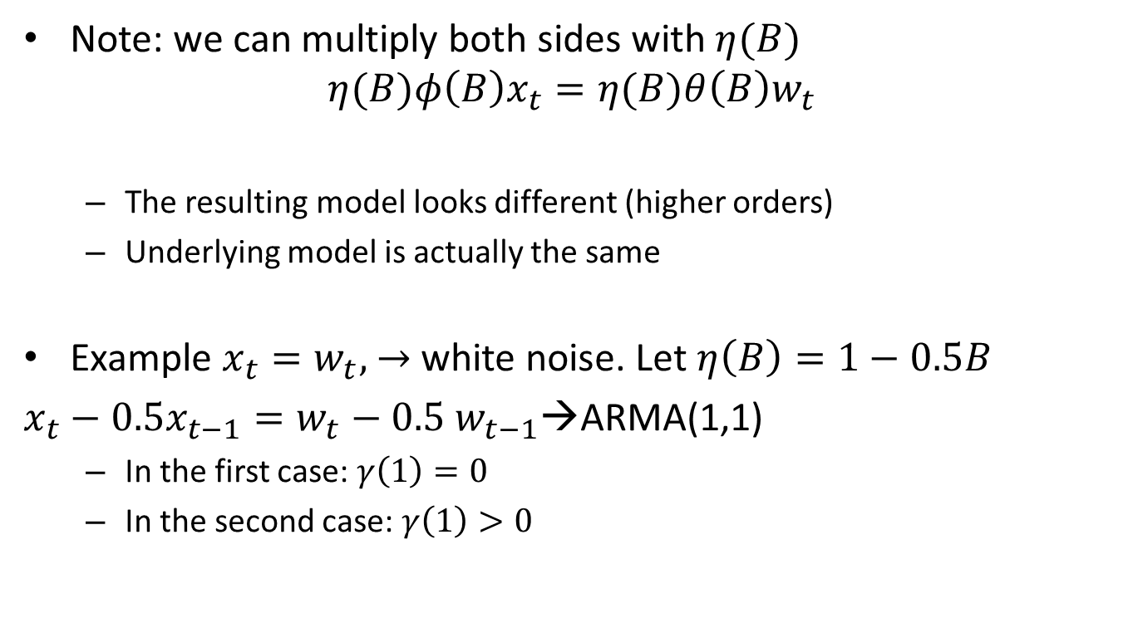
Parameter redundancy
Note: we can multiply both sides with $η(B)$
$$η(B)φ\left(B\right)x_{t}=η(B)θ\left(B\right)w_{t}$$
The resulting model looks different (higher orders)
Underlying model is actually the same
Example $x_{t}=w_{t},$ $→$ white noise. Let $η\left(B\right)=1−0.5B$
$x_{t}−0.5x_{t−1}=w_{t}−0.5 w_{t−1}$→ARMA(1,1)
In the first case: $γ\left(1\right)=0$
In the second case: $γ\left(1\right)>0$

Slide 22
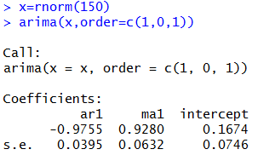

Parameter redundancy
Parameters significant→ seems to be an ARMA(1,1) model!
Over-parametrized $\left(1+0,97B\right)x_{t}=\left(1+0.92B\right)w_{t}$

Slide 23
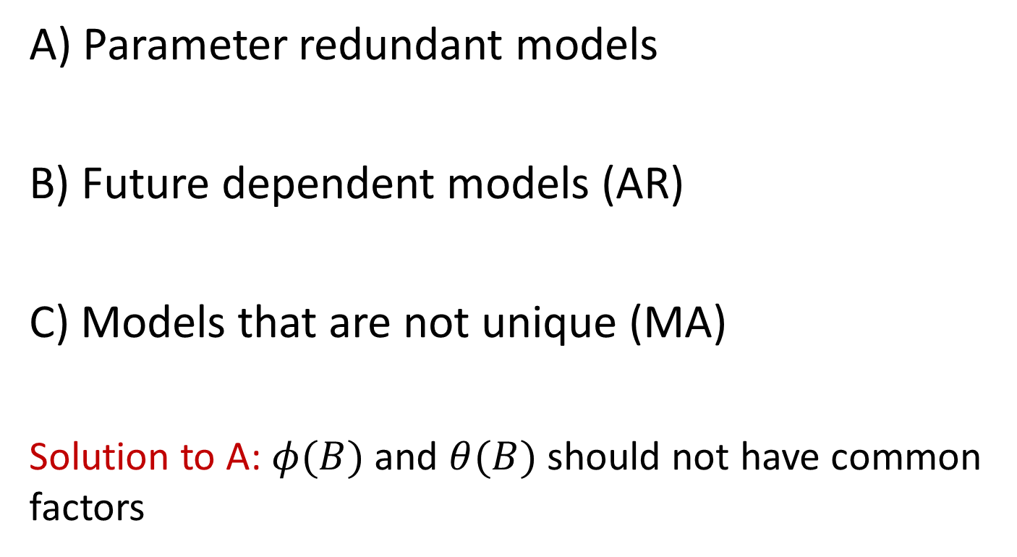
Problems for ARMA
A) Parameter redundant models
B) Future dependent models (AR)
C) Models that are not unique (MA)
Solution to A: $φ(B)$ and $θ(B)$ should not have common factors

Slide 24
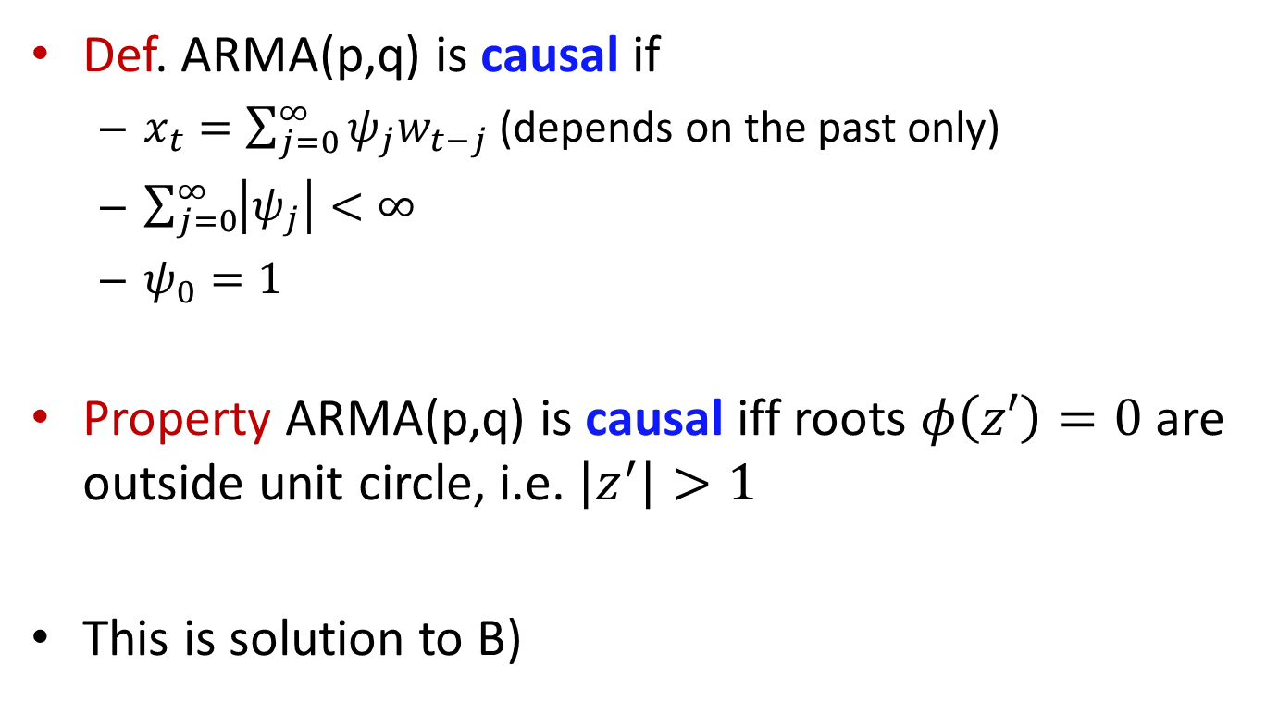
Causal ARMA
Def. ARMA(p,q) is causal if
$x_{t}=\sum_{j=0}^{∞}{ψ_{j}w_{t−j}}$ (depends on the past only)
$\sum_{j=0}^{∞}{\left|ψ_{j}\right|<∞}$
$ψ_{0}=1$
Property ARMA(p,q) is causal iff roots $φ\left(z′\right)=0$ are outside unit circle, i.e. $\left|z^{′}\right|>1$
This is solution to B)

Slide 25


Causal ARMA
Example: Is process causial?
$x_{t}=0.4x_{t−1}+0.3x_{t−2}+0.2x_{t−3}+w_{t}−0.1w_{t−1}$
$φ\left(B\right)=1−0.4B−0.3B^{2}−0.2B^{3}$

Slide 26
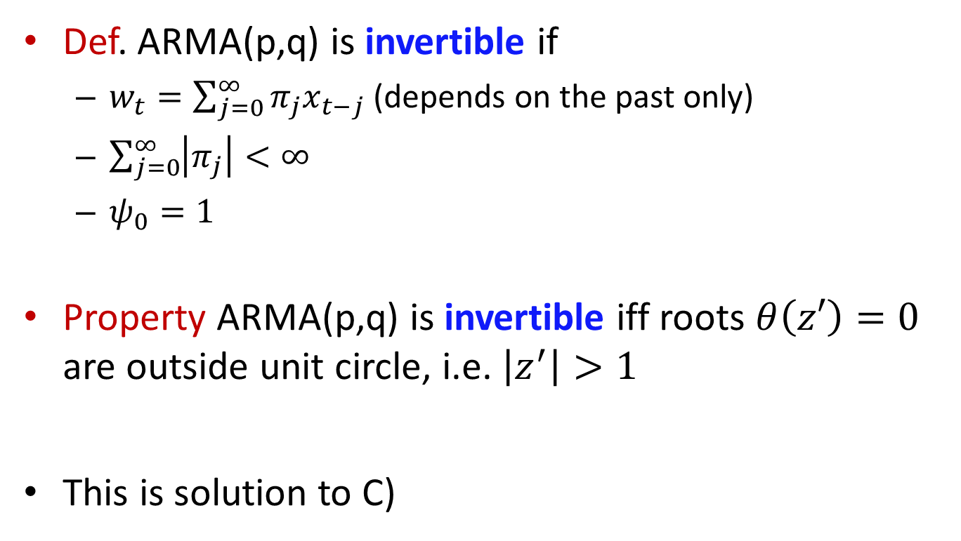
Invertible ARMA
Def. ARMA(p,q) is invertible if
$w_{t}=\sum_{j=0}^{∞}{π_{j}x_{t−j}}$ (depends on the past only)
$\sum_{j=0}^{∞}{\left|π_{j}\right|<∞}$
$ψ_{0}=1$
Property ARMA(p,q) is invertible iff roots $θ\left(z′\right)=0$ are outside unit circle, i.e. $\left|z^{′}\right|>1$
This is solution to C)

Slide 27
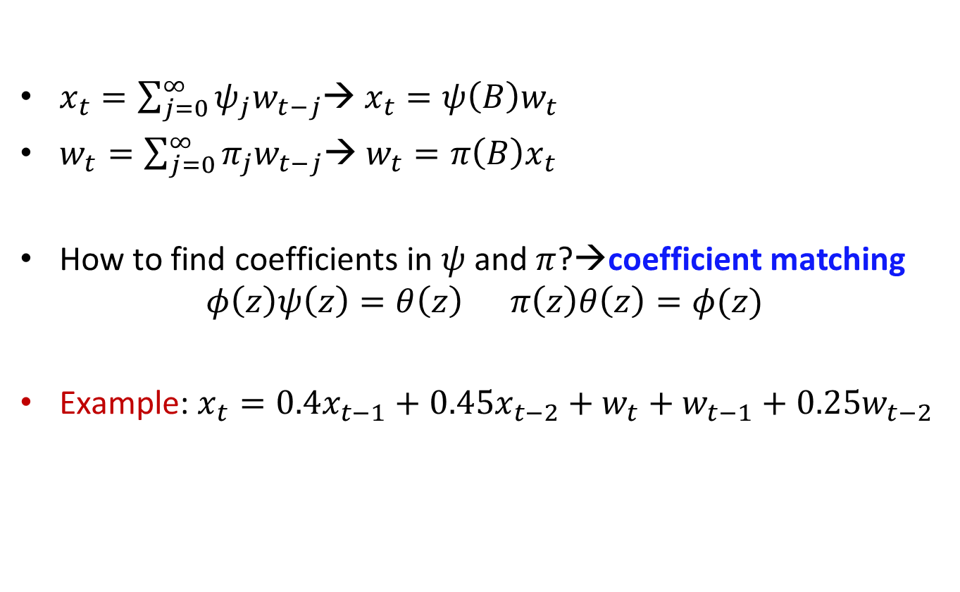
Coefficient matching
$x_{t}=\sum_{j=0}^{∞}{ψ_{j}w_{t−j}}$→ $x_{t}=ψ\left(B\right)w_{t}$
$w_{t}=\sum_{j=0}^{∞}{π_{j}w_{t−j}}$→ $w_{t}=π\left(B\right)x_{t}$
How to find coefficients in $ψ$ and $π$?→coefficient matching
$$φ\left(z\right)ψ\left(z\right)=θ\left(z\right) π\left(z\right)θ\left(z\right)=φ(z)$$
Example: $x_{t}=0.4x_{t−1}+0.45x_{t−2}+w_{t}+w_{t−1}+0.25w_{t−2}$

Slide 28
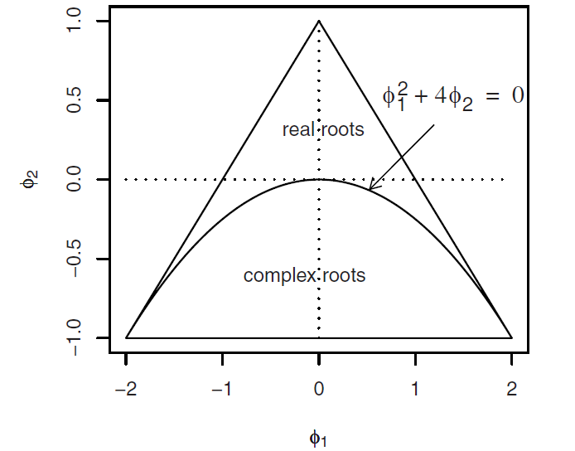

Causality for AR(2)
Roots of $φ\left(z\right)=1−φ_{1}z−φ_{2}z^{2}$ outside unit circle
$φ_{1}+φ_{2}>1, φ_{2}−φ_{1}<1, \left|φ_{2}\right|<1$

Slide 29
Home reading
SS, ch. 3.1
R code: arima.sim, arima, polyroot, ARMAtoMA, ARMAacf
Check carefully arima() docs to see how ar and ma coefficients are specified in the software

